Slide 1
Overcoming Overpopulation in India
A Giant Task
India has 2.4 % of world’s land area but
It is home to 18% of world’s population

Slide 2
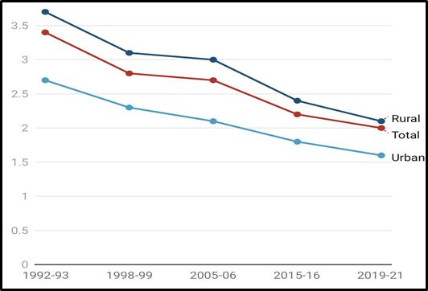
Pre Existing Polices
And its results
Assam, Gujarat, Maharashtra, Telangana, Odisha , Rajasthan and many more states have some for of 2 child policy that determines eligibility for contesting elections or entering government service.
1
2
More than 35 two-child policies have been tabled since Independence.
Results
Although there has been a consistent drop in TFR, there have been several unintended and harming consequences, like desertation of wives, sex-selection and termination of female foetuses.
Total Fertility Rate (TFR)

Slide 3
Phased Rolling Out of Policies and Measures
Your Subtitle Here
Year 0 – Year 4
Aggressive Campaigning and Awareness Raising
Year 4
Begin Implementation of Ammendment to Marriage Age and Encouraging Sterilization
Year 10
Begin Implementation of TFR Act
10₊
Gradual Intensifying the Penalties under TFR Act
STRATEGY

Slide 4
Statistics
1
Women who married/gave birth during early /late adolescence, on average, have 2.2 to 2.3/ 1.4 to 1.5 more children than those who have married/become mothers as adults.
66.7 %
2
Number of women using Family Planning Method( contraception ).
3
There are around 121 million or 12.1 crore unintended pregnancies across the world every year, and one in every seven of these occur in India, according to a report published by the United Nations Population Fund (commonly known by its old acronym, UNFPA).
The above statistics tell that there is a need for preventing child marriage, promoting contraception and eventually increase the minimum marriage age and is promoting sterilization.

Slide 5
Policies and the Need for Awareness Campaigns (1)
Policy on Changing Marriage Age and its Consequences
The increase in Minimum Age for Marriage will result in multiple benefits like empowering women and will help in controlling overpopulation as it will reduce the time period for which a person remains fertile (after marriage). This will eventually result in lesser births.
There will be substantial resistance to this policy (due to an unorthodox mindset) hence it must be implemented only after massive large-scale awareness campaigns for at least a period of 3 -4 years.
The policy will have to be implemented along with strict policing and law enforcement to ensure the rules are followed.

Slide 6
Policies and the Need for Awareness Campaigns (2)
Promoting Sterilization in Men
The policy will include giving incentive for men between ages 37-55 to sterilize themselves.
The age range will be right as most people would be mature enough by 37 and also the men remain fertile only around 5 years of age.
The incentive provided could depend on the livelihood of people. For example, for farmers, it could include waivers on manure/seeds/equipment. For people eligible to pay tax, it could include slashing the tax rates.
A similar policy could be introduced for women in the future, depending on the public opinion but introducing in the near future would draw a lot of criticism.

Slide 7
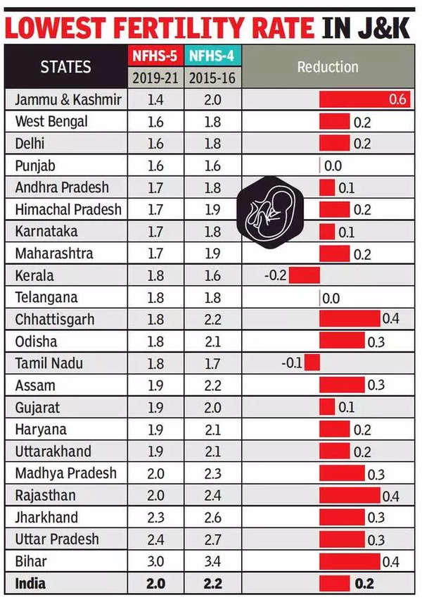
Total Fertility Rate
The average fertility rate in India is the same as the population replacement rate. But there are a few states where there is an extremely positive deviation from the average resulting in uneven distribution of resources therein.
Hence targeted action is needed. But implementation of any such policy in near future would draw major flak from the subject states.
The total fertility rate (TFR) of a population is the average number of children that would be born to a woman over her lifetime
Population replacement rate
Replacement rate is the number of children that a couple would have to have over the course of their reproductive years in order to replace themselves

Slide 8
Long term Policy – Total Fertility Rate Act (TFR Act)
The policy includes giving all the states a time of around 10 years to decrease the total fertility rate to 2.0 and following 10 years there will be gradual implementation of penalties on the states with fertility rates higher than 2.0.
A policy will have to be introduced which would make citizens aware of the need to keep the population replacement rate near 2.0 in the local regions.
The penalties could be imposed on the state as a whole like decrease in budget allocation, increase in tax on fuels, etc.
The penalties would start out as mild and over a few decades the penalties would become more intense

Slide 9
THANK YOU

